Slide 1
Introduction to Classes 2
C# Version

Slide 2
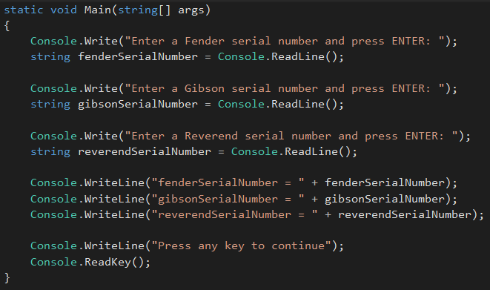
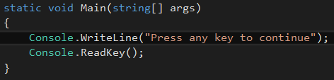
C# Console Application
Open the console Inventory project you created for Introduction to Object-Oriented Programming 1
Erase the code in the Main() method of the Program class except for the last 2 lines “(Press any key…)

Slide 3
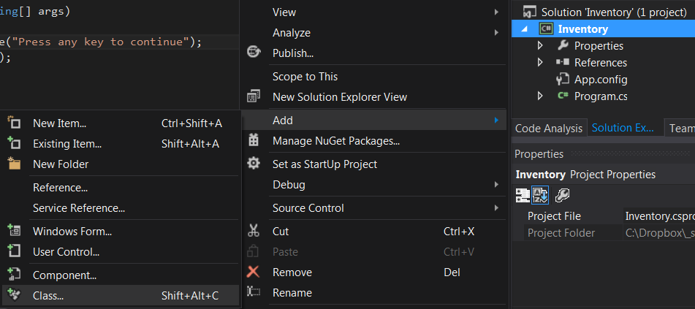
Create a Guitar Class
Right-click on Inventory in the Solution Explorer window, select Add, then select Class

Slide 4
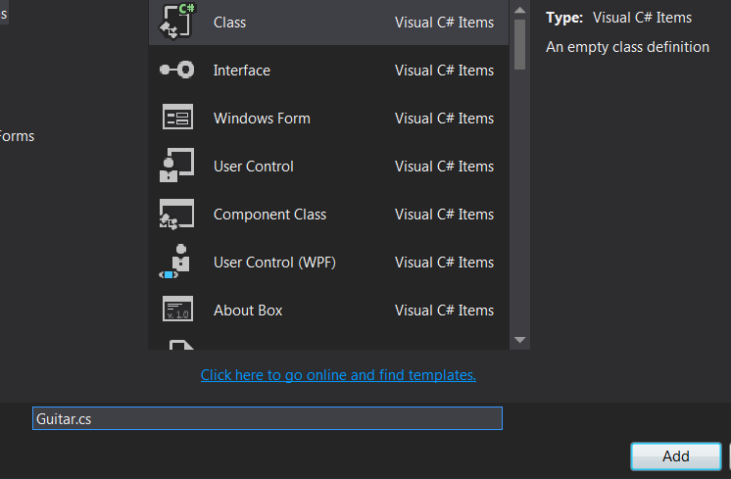
Create a Guitar Class
Name the new class
“Guitar.cs” and click
on Add

Slide 5
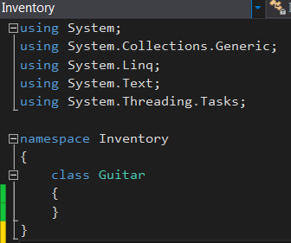
Create a Guitar Class
The empty class definition will look like this:
The empty class definition code is shown on the next slide

Slide 6
class Guitar
{
}

Slide 7
Add a serialNumber Attribute
Add the declaration shown on the next slide
This looks like the variable declaration we did in the Main() method of the Program class
A variable defined inside a method can only be used in that method
We just declared a variable that is not in any method
Because it is not in a method, this declaration is known as a class variable, field or attribute
Attributes can be accessed by any code in the class, not just the code in a method

Slide 8
class Guitar
{
string serialNumber;
}

Slide 9
Make the Attribute private
Add the private keyword before the declaration
This restricts the visibility of the attribute
A private attribute can only be used by code in the class where it is defined

Slide 10
class Guitar
{
private string serialNumber;
}

Slide 11
Add a SerialNumber Property
Add an empty property declaration as shown on the next slide
Notice that the property has public visibility
We will write code in the property to manage reading and writing the value stored in the serialNumber attribute
This pattern of providing a public property for a private attribute is known as “data hiding”

Slide 12
class Guitar
{
private string serialNumber;
public string SerialNumber
{
}
}

Slide 13
Add set Code to the SerialNumber Property
Add the set code shown on the next slide
This set code provides a public interface for assigning a value to the private serialNumber attribute
We can write validation code to check the value before it is stored in the attribute

Slide 14
class Guitar
{
private string serialNumber;
public string SerialNumber
{
set
{
serialNumber = value;
}
}
}

Slide 15
Add get Code to the SerialNumber Property
Add the get code shown on the next slide
This set code provides a public interface for retrieving the value from the private serialNumber attribute
We can write code to manipulate the value before it is returned

Slide 16
Data Hiding
This pattern of providing a public accessor and a public mutator for a private attribute is known as “data hiding”
Data hiding is an aspect of encapsulation

Slide 17
class Guitar
{
private string serialNumber;
public string SerialNumber
{
set
{
serialNumber = value;
}
get
{
return serialNumber;
}
}
}

Slide 18
Add a ToString() Method
A method is a named chunk of code that can be called to perform a task
Add the ToString() method code shown on the next slide
The ToString() method returns the values stored in an object’s attribute(s)
Note that the visibility of the ToString() method is public

Slide 19
class Guitar
{
private string serialNumber;
public string SerialNumber
{
set
{
serialNumber = value;
}
get
{
return serialNumber;
}
}
public override string ToString()
{
return "serialNumber = " + serialNumber;
}
}

Slide 20
Instantiate a Guitar object
Open the Program class and add the code shown on the next slide
This code instantiates a Guitar object
Classes are code that is developed by a programmer during system development
Objects are created from classes when a program is running
When an object is instantiated, a chunk of computer memory is allocated in a part of memory called the “heap”
Attribute values are stored in this chunk of memory

Slide 21
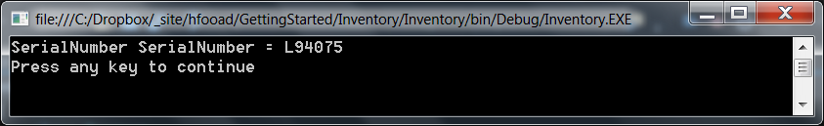
class Program
{
static void Main(string[] args)
{
Guitar guitar = new Guitar();
guitar.SerialNumber = "L94075";
Console.WriteLine(guitar.ToString());
Console.WriteLine("Press any key to continue");
Console.ReadKey();
}
}

Slide 22
Instantiate Multiple Guitar Objects
Add the code shown on the next slide to instantiate multiple Guitar objects

Slide 23
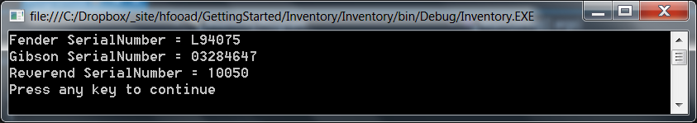
class Program
{
static void Main(string[] args)
{
Guitar fender = new Guitar();
Guitar gibson = new Guitar();
Guitar reverend = new Guitar();
fender.SerialNumber = "L94075";
gibson.SerialNumber = "03284647";
reverend.SerialNumber = "10050";
Console.WriteLine("Fender " + fender.ToString());
Console.WriteLine("Gibson " + gibson.ToString());
Console.WriteLine("Reverend " + reverend.ToString());
Console.WriteLine("Press any key to continue");
Console.ReadKey();
}
}

Slide 24
See Introduction to Classes 3.pptx

